Slide 1
Natural (Free) Cubic Spline
Notes:
http://aero-comlab.stanford.edu/Papers/splines.pdf
https://towardsdatascience.com/numerical-interpolation-natural-cubic-spline-52c1157b98ac

Slide 2
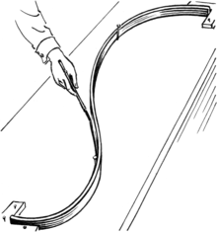
Spline
History
The word "spline" was originally an East Anglian dialect word.
It is commonly accepted that the first mathematical reference to splines is the 1946 paper by Isaac Jacob Schoenberg.
However, the ideas have their roots in the aircraft and shipbuilding industries.
Lofting
To construct templates for airplanes by passing thin wooden strips (called "splines") through points laid out on the floor of a large design loft, a technique borrowed from ship-hull design.
Notes:
https://en.wikipedia.org/wiki/Spline_(mathematics)#:~:text=It%20is%20commonly%20accepted%20that,the%20aircraft%20and%20shipbuilding%20industries.

Slide 3
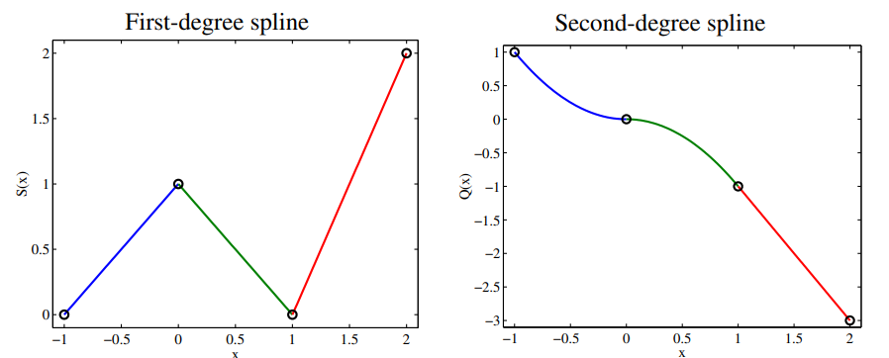
Why “Cubic” Spline?
For first-degree splines, the slope of the spline may change abruptly at the knots.
For second-degree splines, the discontinuity is in the second derivative which means that the curvature of the quadratic spline changes abruptly at each node
Notes:
Higher-degree splines are useful whenever more smoothness is needed in the approximating function.

Slide 4
Cubic Spline Interpolation
Spline is a special function defined piecewise by polynomial of degree k that is continuously differentiable k-1 times.
Cubic Spline interpolation used very often to avoid the problem of Runge’s phenomenon.
It gives a smoother and has smaller error interpolating polynomial.
Notes:
Runge’s phenomenon - Is a problem of oscillation at the edges of an interval that occurs when using polynomial interpolation with polynomials of high degree over a set of equally spaced interpolation points.

Slide 5
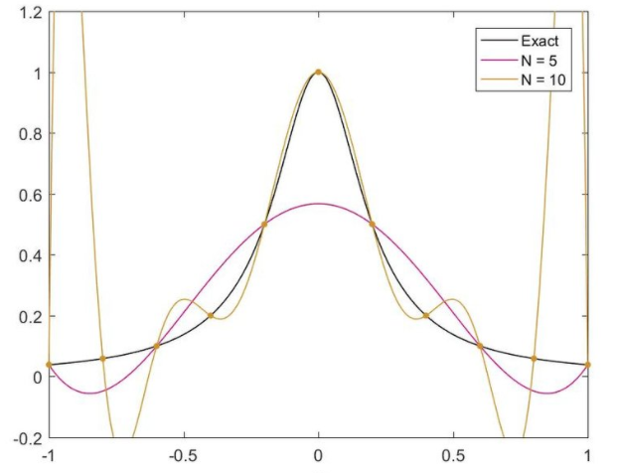
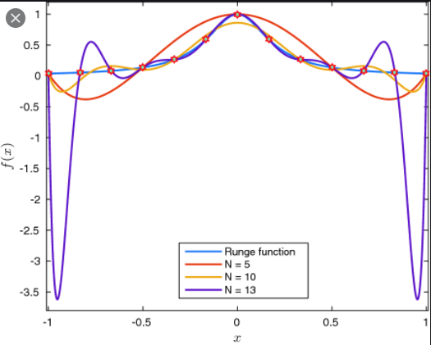
Runge’s Phenomenon

Slide 6
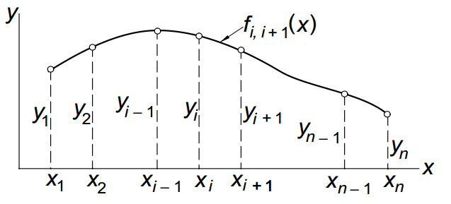

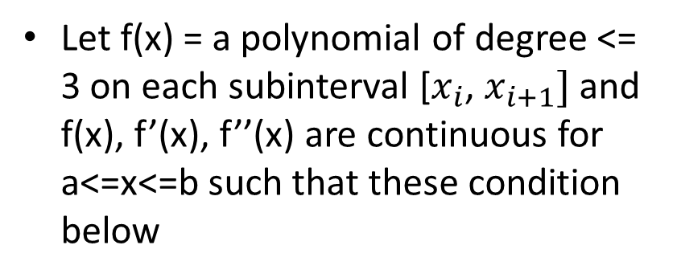
Algorithm for “Natural” cubic spline
Let f(x) = a polynomial of degree <= 3 on each subinterval [$x_{i}$, $x_{i+1}]$ and f(x), f’(x), f’’(x) are continuous for a<=x<=b such that these condition below

Slide 7
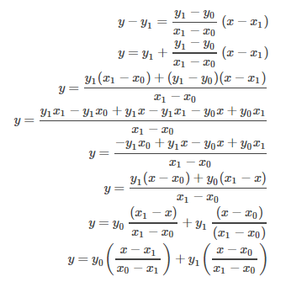
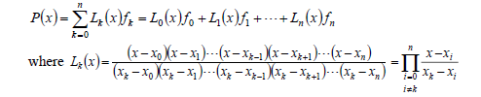
Lagrange’s two-point interpolation

Slide 8
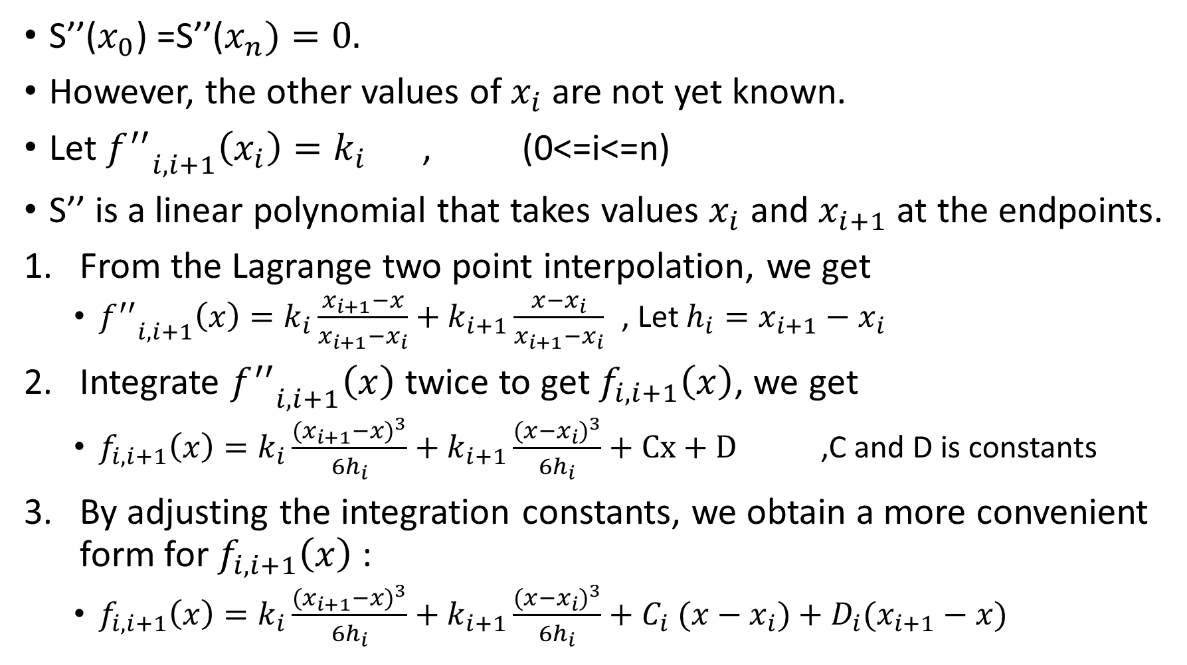
S’’($x_{0}$) =S’’($x_{n})=0.$
However, the other values of $x_{i}$ are not yet known.
Let ${f^{′′}}_{i,i+1}\left(x_{i}\right)=k_{i}$ , (0<=i<=n)
S’’ is a linear polynomial that takes values $x_{i}$ and $x_{i+1}$ at the endpoints.
From the Lagrange two point interpolation, we get
${f^{′′}}_{i,i+1}\left(x\right)=k_{i}\frac{x_{i+1}−x}{x_{i+1}−x_{i}}+k_{i+1}\frac{x−x_{i}}{x_{i+1}−x_{i}}$ , Let $h_{i}=x_{i+1}−x_{i}$
Integrate ${f^{′′}}_{i,i+1}\left(x\right)$ twice to get $f_{i,i+1}\left(x\right)$, we get
$f_{i,i+1}\left(x\right)=k_{i}\frac{{{(x}_{i+1}−x)}^{3}}{{6h}_{i}}+k_{i+1}\frac{{(x−x_{i})}^{3}}{6h_{i}}+Cx+D$ ,C and D is constants
By adjusting the integration constants, we obtain a more convenient form for $f_{i,i+1}\left(x\right)$ :
$f_{i,i+1}\left(x\right)=k_{i}\frac{{{(x}_{i+1}−x)}^{3}}{{6h}_{i}}+k_{i+1}\frac{{(x−x_{i})}^{3}}{6h_{i}}+C_{i} (x−x_{i})+{D_{i}(x}_{i+1}−x)$

Slide 9
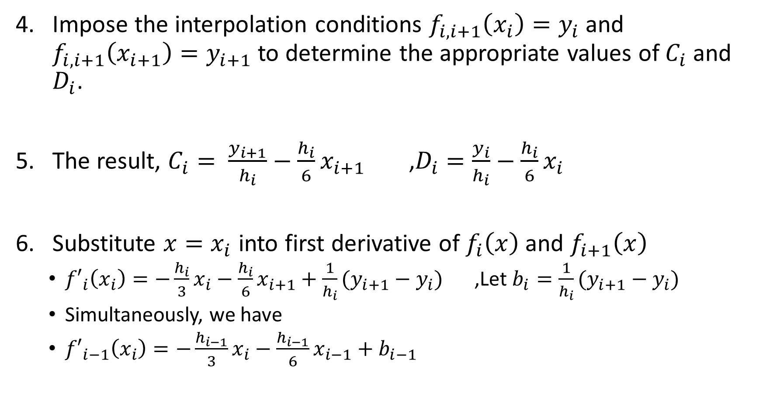
Impose the interpolation conditions $f_{i,i+1}\left(x_{i}\right)=y_{i}$ and $f_{i,i+1}\left(x_{i+1}\right)=y_{i+1}$ to determine the appropriate values of $C_{i}$ and $D_{i}$.
The result, $C_{i}= \frac{y_{i+1}}{h_{i}}−\frac{h_{i}}{6}x_{i+1}$ ,$D_{i}=\frac{y_{i}}{h_{i}}−\frac{h_{i}}{6}x_{i}$
Substitute ${x=x}_{i}$ into first derivative of $f_{i}\left(x\right)$ and $f_{i+1}\left(x\right)$
${f′}_{i}\left(x_{i}\right)=−\frac{h_{i}}{3}x_{i}−\frac{h_{i}}{6}x_{i+1}+\frac{1}{h_{i}}(y_{i+1}−y_{i})$ ,Let $b_{i}=\frac{1}{h_{i}}(y_{i+1}−y_{i})$
Simultaneously, we have
${f′}_{i−1}\left(x_{i}\right)=−\frac{h_{i−1}}{3}x_{i}−\frac{h_{i−1}}{6}x_{i−1}+b_{i−1}$

Slide 10

Now determine the $x_{i}$ by using ${f^{′}}_{i−1}\left(x_{i}\right)={f^{′}}_{i}\left(x_{i}\right)$.
Finally, we get
$h_{i−1}x_{i−1}+2\left(h_{i−1}+h_{i}\right)x_{i}+h_{i}x_{i+1}=6(b_{i}$-$b_{i−1})$
For 1 <= I <= n-1 ,
By letting $u_{i}=2\left(h_{i−1}+h_{i}\right)$, $v_{i}=$ $6(b_{i}$-$b_{i−1})$, z=x,

Slide 11
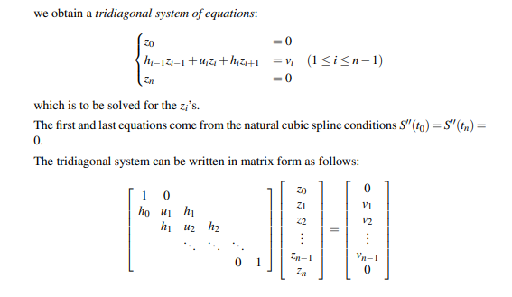

Slide 12
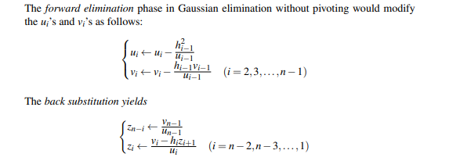

Slide 13
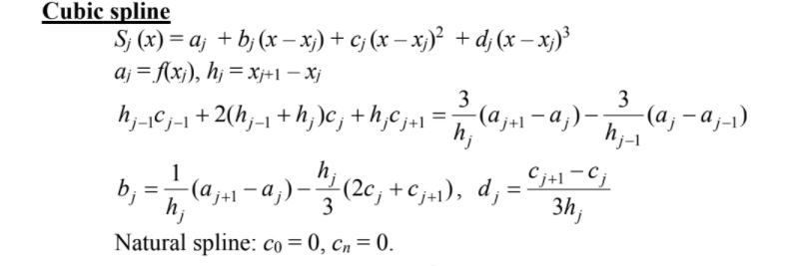
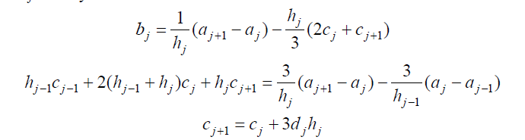
HOW TO FIND THE ANSWER?
,

Slide 14
Application
In medical, natural cubic splines are suitable for the estimation of the relationship between heavy metals concentrations in hair and health indices.
In power system operation, available transfer capability calculation, electric arc furnace modeling, static var compensation, voltage stability margin and market power estimation
Notes:
The estimator of function f(x), which defines dependence of health index on heavy metal concentration, is a cubic spline.
Link: Medical https://journals.lww.com/epidem/Abstract/2003/09001/Application_of_Natural_Cubic_Splines_for_Heavy.80.aspx
Link: Power system operation https://www.intechopen.com/books/topics-in-splines-and-applications/application-of-cubic-spline-interpolation-technique-in-power-systems-a-review

Slide 15
EXCEL FORMULA

Slide 16
THANK YOU

